Slide 1
Inclusive Education:
Individualized Education Programs.
Preparing yourself and your child for the 2020-2021 school year
ARCH Disability Law Centre and Disability Alliance BC
Inclusive Education:
Individualized Education Programs
Preparing yourself and your child for the 2020-2021 school year
Hina Ghaus
ARCH Disability Law Centre
Andrew Robb
Disability Alliance B.C.
September 15, 2020

Slide 2
Roadmap
Roadmap
About ARCH and DABC
International Framework - UN CRPD
Human Rights and Education
Individualized Education Programs/Plans
Responsibilities and Advocacy Tips
Questions

Slide 3
1. About ARCH and DABC
1. About ARCH and DABC

Slide 4
ARCH – An important part of the legal system
ARCH – An important part of the legal system
ARCH Disability Law Centre is a specialty legal clinic that practices exclusively in disability rights law
Since incorporation in 1979, ARCH has been a leader in disability rights advocacy and test case litigation.
ARCH is dedicated to defending and advancing the equality rights, entitlements, fundamental freedoms and inclusion of persons with disabilities with low income in Ontario
ARCH is primarily funded by Legal Aid Ontario

Slide 5
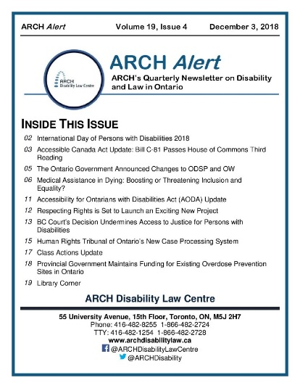
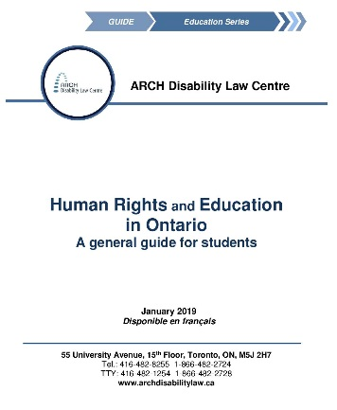
ARCH Services
ARCH Services
Test Case Litigation
Public Legal Education
ARCH Alert
Publications
Summary Advice and Referral Service

Slide 6
Disability Law Clinic at Disability Alliance BC
Disability Law Clinic at Disability Alliance BC
The Disability Law Clinic is a new program of DABC. We opened in March 2020
It is the first community law clinic in BC that specialises in Disability Rights Law
We provide free legal advice and assistance to people with disabilities who live in BC, in some disability-related areas of law

Slide 7
2. International Framework – UN CRPD
2. International Framework – UN CRPD

Slide 8
Convention on the Rights of Persons with Disabilities (CRPD)
Convention on the Rights of Persons with Disabilites (CRPD)
Article 24 states, in part:
“State Parties recognise the right of persons with disabilities to education … without discrimination and on the basis of equal opportunity, State Parties shall ensure an inclusive education system at all levels … .”
UN General Assembly, Convention on the Rights of Persons with Disabilities : resolution / adopted by the General Assembly, 24 January 2007, A/RES/61/106

Slide 9
Convention on the Rights of Persons with Disabilities (CRPD)
continued
Convention on the Rights of Persons with Disabilites (CRPD)
Obligations that State Parties must ensure include:
Persons with disabilities are not excluded from the general education system on the basis of disability, …;
Persons with disabilities can access an inclusive, quality and free primary education and secondary education on an equal basis with others in the communities in which they live;
Reasonable accommodation of the individual’s requirements is provided;
Persons with disabilities receive the support required, within the general education system, to facilitate their effective education;
Effective individualised support measures are provided in environments that maximize academic and social development, consistent with the goal of full inclusion.

Slide 10
3. Human Rights and Education
3. Human Rights and Education

Slide 11
Human Rights and Education
Human Rights and Education
The right to education of a child with a disability is protected by multiple pieces of international legislation
However, Canada has no federal legislation protecting a child with a disability’s right to inclusive education because education comes under provincial and territorial jurisdiction
Policies on inclusive education vary widely

Slide 12
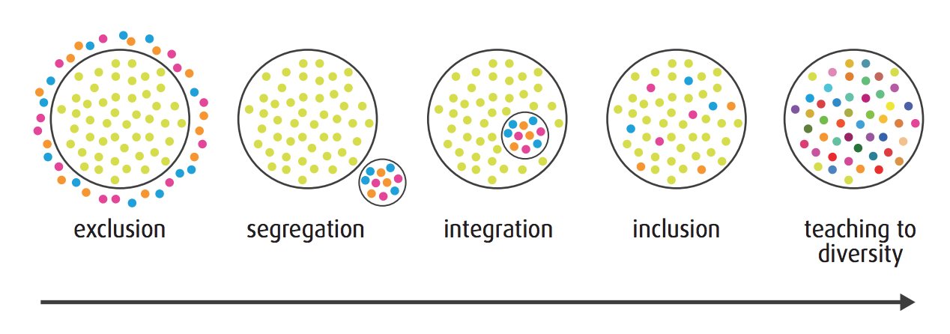
Inclusive Education
Inclusive Education
No single definition of “inclusive education”
E.g.: “Education that is based on the principles of acceptance and inclusion of all students. Students see themselves reflected in their curriculum, their physical surroundings and the broader environment, in which diversity is honoured and all individuals are respected.” - Ontario’s Equity and Inclusive Education Strategy, 2009
Image from: Inclusion BC “Implementing Inclusion in BC’s Public Schools” Report on the June 14, 2017 Inclusive Education Summit (Richmond BC).

Slide 13
Human Rights Laws Across Canada
Human Rights Laws Across Canada
Province/Territory | Human Rights Laws
AB | Alberta Human Rights Act
BC | British Columbia Human Rights Code
MB | Manitoba Human Rights Code
NB | New Brunswick Human Rights Act
NL | Newfoundland & Labrador Human Rights Act
NS | Nova Scotia Human Rights Act
ON | Ontario Human Rights Code
PEI | Prince Edward Island Human Rights Act
QB | Quebec Charter of Rights and Freedoms
SK | Saskatchewan Human Rights Code
NT | Northwest Territories Human Rights Act
NU | Nunavut Human Rights Act
YT | Yukon Human Rights Act

Slide 14
Ontario’s Human Rights Approach in Education
Ontario’s Human Rights Approach in Education
Canadian Charter of Rights & Freedoms (Constitution Act of Canada)
Ontario's Human Rights Code
Education Act
Education Act Regulations
Policy/Program Memoranda
School Board Policies

Slide 15
Ontario’s Human Rights Code: What’s Covered
Ontario’s Human Rights Code: What’s Covered
The Code guarantees freedom from discrimination and harassment regardless of disability and/or other protected grounds;
The Code applies to delivery of services including education
Education is considered a service under the Code
“Disability” is defined differently depending on the particular law in operation
More than just “exceptionality”

Slide 16
What is Discrimination?
What is Discrimination?
Generally, discrimination means:
treating people differently because of their disability, and
the different treatment hurts, harms, offends or prevents someone from getting where they need to go, getting what they need or reaching their goals.
Discrimination also includes situations where a rule or policy seems to apply to everyone equally, but in practice has a negative impact on certain groups of people.

Slide 17
The Duty to Accommodate
The Duty to Accommodate
Generally, those who provide education services have a duty to accommodate the needs of students with disabilities;
Accommodation refers to the prevention and removal of individual and systemic barriers;
Disability accommodations must be provided unless undue hardship is proven.

Slide 18
Examples of Accommodations
Examples of Accommodations
Extra time for completing tests and assignments
Alternative forms of evaluation
Academic materials in alternative formats
Provision of and training on adaptive technology
In-class assistance and supports

Slide 19
Undue Hardship
Undue Hardship
Overall, disability accommodations must be provided up to the point of undue hardship
Undue hardship under Ontario’s Human Rights Code consists of:
costs;
outside sources of funding, if any; and
health and safety requirements, if any.

Slide 20
Components of the Duty to Accommodate
Components of the Duty to Accommodate
Duty to accommodate is both substantive and procedural
Substantive = considers the appropriateness of the accommodation provided or whether it cannot be provided because of undue hardship
Procedural = the methods and approach to developing and implementing the accommodation

Slide 21
Components of the Duty to Accommodate continued
Components of the Duty to Accommodate
Substantive | Procedural
Accommodations are: appropriate, individualized, respect the dignity of the student | Educators to: take appropriate steps to sufficiently determine an appropriate accommodation
highly individualized | conduct an individualized assessment of the student
to consider strengths, needs and requirements of the student, and the context | consult with experts and others to gather information relevant to providing accommodation (where necessary)
provided in a timely manner

Slide 22
Notable Decisions
Notable Decisions
Supreme Court of Canada decision in Moore v. British Columbia (Education), 2012 SCC 61;
This decision provides guidance on how human rights cases within the education context are to be adjudicated;

Slide 23
4. Individualized Education Programs/ Plans
4. Individualized Education Programs/Plans

Slide 24
Human Rights and Inclusive Education
Human Rights and Inclusive Education
Ontario’s Education Act
Governs all publically funded elementary and secondary education services
Sets out rules and timelines for the Identification, Placement, and Review Committee (IPRC)
The Act puts an obligation on the principal and the school board to create an Individual Education Plan (IEP)
You do not have to be “identified” in order to have your needs accommodated

Slide 25
Identification, Placement and Review Committee’s (IPRCs)
Identification, Placement and Review Committee’s (IPRCs)
Ontario’s Education Act
IPRCs are essentially the mechanism by which placements are chosen
IPRC process can be started by parent/guardian or the principal
Before considering placing a student in a special education class, committee must first consider whether placement in a regular class, with appropriate special education programs and services, would meet the student's needs and be consistent with the parent's preferences

Slide 26
Identification, Placement and Review Committee’s (IPRCs) continued
Identification, Placement and Review Committee’s (IPRCs)
Ontario’s Education Act
Remember that a school is still required to provide services, programming and accommodations regardless of whether an IPRC has been conducted
IPRC’s may be appropriate in certain situations and not in others

Slide 27
IEPs in BC
IEPs in BC
In BC, there is no equivalent to the IPRC
Schools must ensure that IEPs are created for all students who have special needs
Special needs are defined as disabilities “of an intellectual, physical, sensory, emotional or behavioral nature” and learning disabilities

Slide 28
IEPs in BC continued
IEPs in BC
Students with special needs must be placed in integrated classrooms unless their educational needs, or the educational needs of other students, indicate that a different placement would be better
If a parent believes a child would benefit from an IEP, ask the teacher for a meeting with the “school-based team” which assists the teacher to plan for students with special needs

Slide 29
BC: Appealing a school’s decision
BC: Appealing a school’s decision
BC’s School Act allows a parent or student to appeal any decision that “significantly affects the education, health or safety of a student”. This includes decisions about IEPs
The board must make a decision about the appeal within 45 days
You can submit a further appeal to the Superintendent of Appeals

Slide 30
Individual Education Plans (IEPs)
Individual Education Plans (IEPs)
In general, IEPs are essentially accommodation plans
Written by school in consultation with parents/student
They set out learning expectations, and an outline of how the student’s progress will be evaluated

Slide 31
Individual Education Plans (IEPs) continued
Individual Education Plans (IEPs)
General Issues to be Address in an IEP
Student’s strengths and needs
Student’s current level of achievement
Annual program goals
Learning expectations
Teaching strategies, accommodations and resources
Assessment, Evaluation, and Reporting
Transition Plan
Parent/Student Consultation
SOURCE: The Ministry of Education, Individual Education Plans: Standards for Development, Program Planning, and Implementation, 2000

Slide 32
IEPs during COVID-19
IEPs during COVID-19
In general, school boards must ensure that IEPs, as accommodation plans for students with disabilities, reflect the current needs of students with disabilities accessing education services within the COVID-19 context
Need for IEPs to be followed
Need for plans to be revised as appropriate

Slide 33
IEPs in BC
IEPs in BC
If teacher or parent suspects a child would benefit from an IEP, they can ask the school for a meeting of the school-based team
The IEP is usually developed by a case manager or research teacher, in consultation with parents/guardians, at an IEP meeting
It is not necessary to get a formal diagnosis of a disability, but it helps a lot

Slide 34
Examples of issues during COVID-19
Examples of issues during COVID-19
Access to technology
accessible online platforms/materials
Students with disabilities must not be excluded from school

Slide 35
5. General Responsibilities & Advocacy Tips
5. General Responsibilities & Advocacy Tips

Slide 36
Examples of Problems
Examples of Problems
Students denied:
timely and appropriate accommodation;
interim or alternate accommodation;
Students and parents denied participatory rights in accommodation identification and development;
Students in regular class placement in elementary school pressured to transition to segregated placement in secondary school;
* These examples are drawn from ARCH’s work with parents & students with disabilities

Slide 37
Examples of Problems continued
Examples of Problems
Students with intellectual disabilities are disproportionately impacted;
Improper use of behaviour/discipline legislation;
Barriers when transitioning to middle school, high school and transitioning out of the education system.
* These examples are drawn from ARCH’s work with parents & students with disabilities

Slide 38
Responsibilities of Parents / Guardians & Students
Responsibilities of Parents/Guardians & Students
Tell the education provider about need for disability-related accommodations;
Make his or her needs known so that the education provider can implement an appropriate accommodation;
Assist and collaborate in finding accommodations by providing relevant information, answering questions, co-operating with experts, participating in discussions, etc.
Source: Ontario Human Rights Commission’s Guidelines on Accessible Education

Slide 39
Responsibilities of Education Service Provider
Responsibilities of Education Service Provider
Advise students, or their parent/guardian of available accommodations, and the process to obtain them
Investigate and canvass possible accommodation solutions
Where necessary, obtain expert opinion or advice (costs are to be borne by the education provider)
Provide accommodations in a timely manner
Source: Ontario Human Rights Commission’s Guidelines on Accessible Education

Slide 40
The Value of Informal Processes
The Value of Informal Processes
Informal conflict resolution is often the most effective approach
Informal processes can involve all interested parties, and allow for timely solutions to problems – formal processes can take much longer and be detrimental to students
These processes may include the help of a third-party facilitator
Source: Ministry of Education. Shared Solutions: A Guide to Preventing and Resolving Conflicts Regarding Programs and Services for Students with Special Needs (Toronto: 2007).

Slide 41
Advocacy Checklist
Advocacy Checklist
Use relevant P/T guidelines to help you negotiate with the teacher, principal or Superintendent of Special Education for accommodations
Keep contemporaneous notes of conversations with teachers, principal, Superintendent of Special Education
If going in for a longer meeting, consider bringing someone with you to take notes
Keep copies of school records, letters sent to and from school

Slide 42
Advocacy Checklist continued
Advocacy Checklist
Go up the chain: first talk to the teacher, then the IEP team or Principal, before appealing to the School Board
If possible, get all communications in writing or by email
If you don’t get a reply promptly, keep going up the chain

Slide 43
Advocacy checklist continued
Advocacy Checklist
Consult and get the support of outside professionals if required
(e.g. MD, social worker, psychologist etc.)
If needed, keep track of behaviours and/or incidents
Explore informal resolution processes
Call your provincial legal clinics for legal information and advice
Consider whether a human rights application may be appropriate

Slide 44
More advocacy tips
More Advocacy Tips
Make sure IEP refers to all accommodations provided, in writing
Always try to empathize with teachers. You want to make sure they get the resources they need.

Slide 45
BC Advocacy Resources
BC Advocacy Resources
Inclusion BC, inclusionbc.org
Family Support Institute of BC, familysupportbc.com

Slide 46
Thank You!
Thank you!
1450-605 Robson Street
Vancouver, BC V6B 5J3
236 427 1108
LawClinic@disabilityalliancebc.org
www.disabilityalliancebc.org
55 University Avenue, 15th Floor
Toronto, ON, M5J 2H7
Tel: 416-482-8255 or 1-866-482-2724
TTY: 416-482-1254 or 1-866-482-2728
Fax: 416-482-2981 or 1-866-881-2723
www.archdisabilitylaw.ca
@ARCHDisability
@ARCHDisabilityLawCentre

Slide 47
6. Questions
6. Questions?

