Slide 1
Supporting Reading At Home

Slide 2
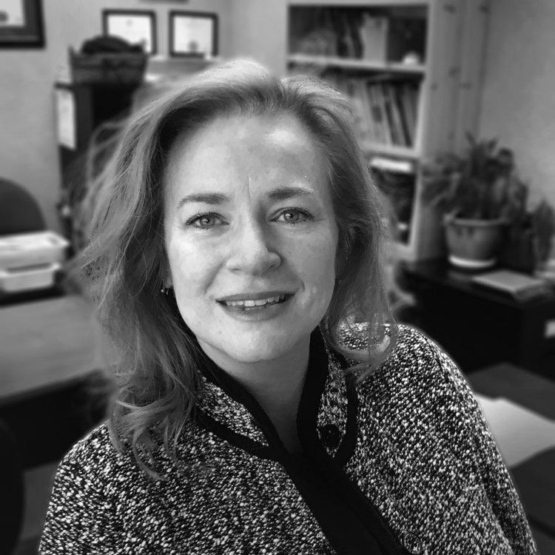
Introductions
Corey Zylstra, M.Ed., CEO and Founder, Reach OG Learning Centres
Rachel Breau, Manager, Member Services, Centre for Equitable Library Access

Slide 3
Agenda
The role of parents and other stakeholders to support reading at home
Appropriate and Accessible Content
Where can you find appropriate materials?
How can you build an accessible, appropriate and fun library (at home and school)?
Q & A

Slide 4
Supporting Reading at Home
The Role of Parents
Notes:
(Corey) The role of parents- encourage, support, make time, be ready to read with, to, and to listen

Slide 5
Dyslexia and other Reading Disabilities
Word-level reading difficulties (dyslexia) affect a substantial portion of the general population, with some estimates ranging from 6 to 17%.
Fletcher, 2009
Notes:
Corey- Dyslexia affects many - continuum,

Slide 6
Automatic reading is fast, accurate and effortless word identification at the single word level. The speed and accuracy with which single words are identified is the best predictor of comprehension.
Hook & Jones, 2002
Notes:
Corey- Goal of reading is to understand, bring joy of reading with appropriate exposure

Slide 7
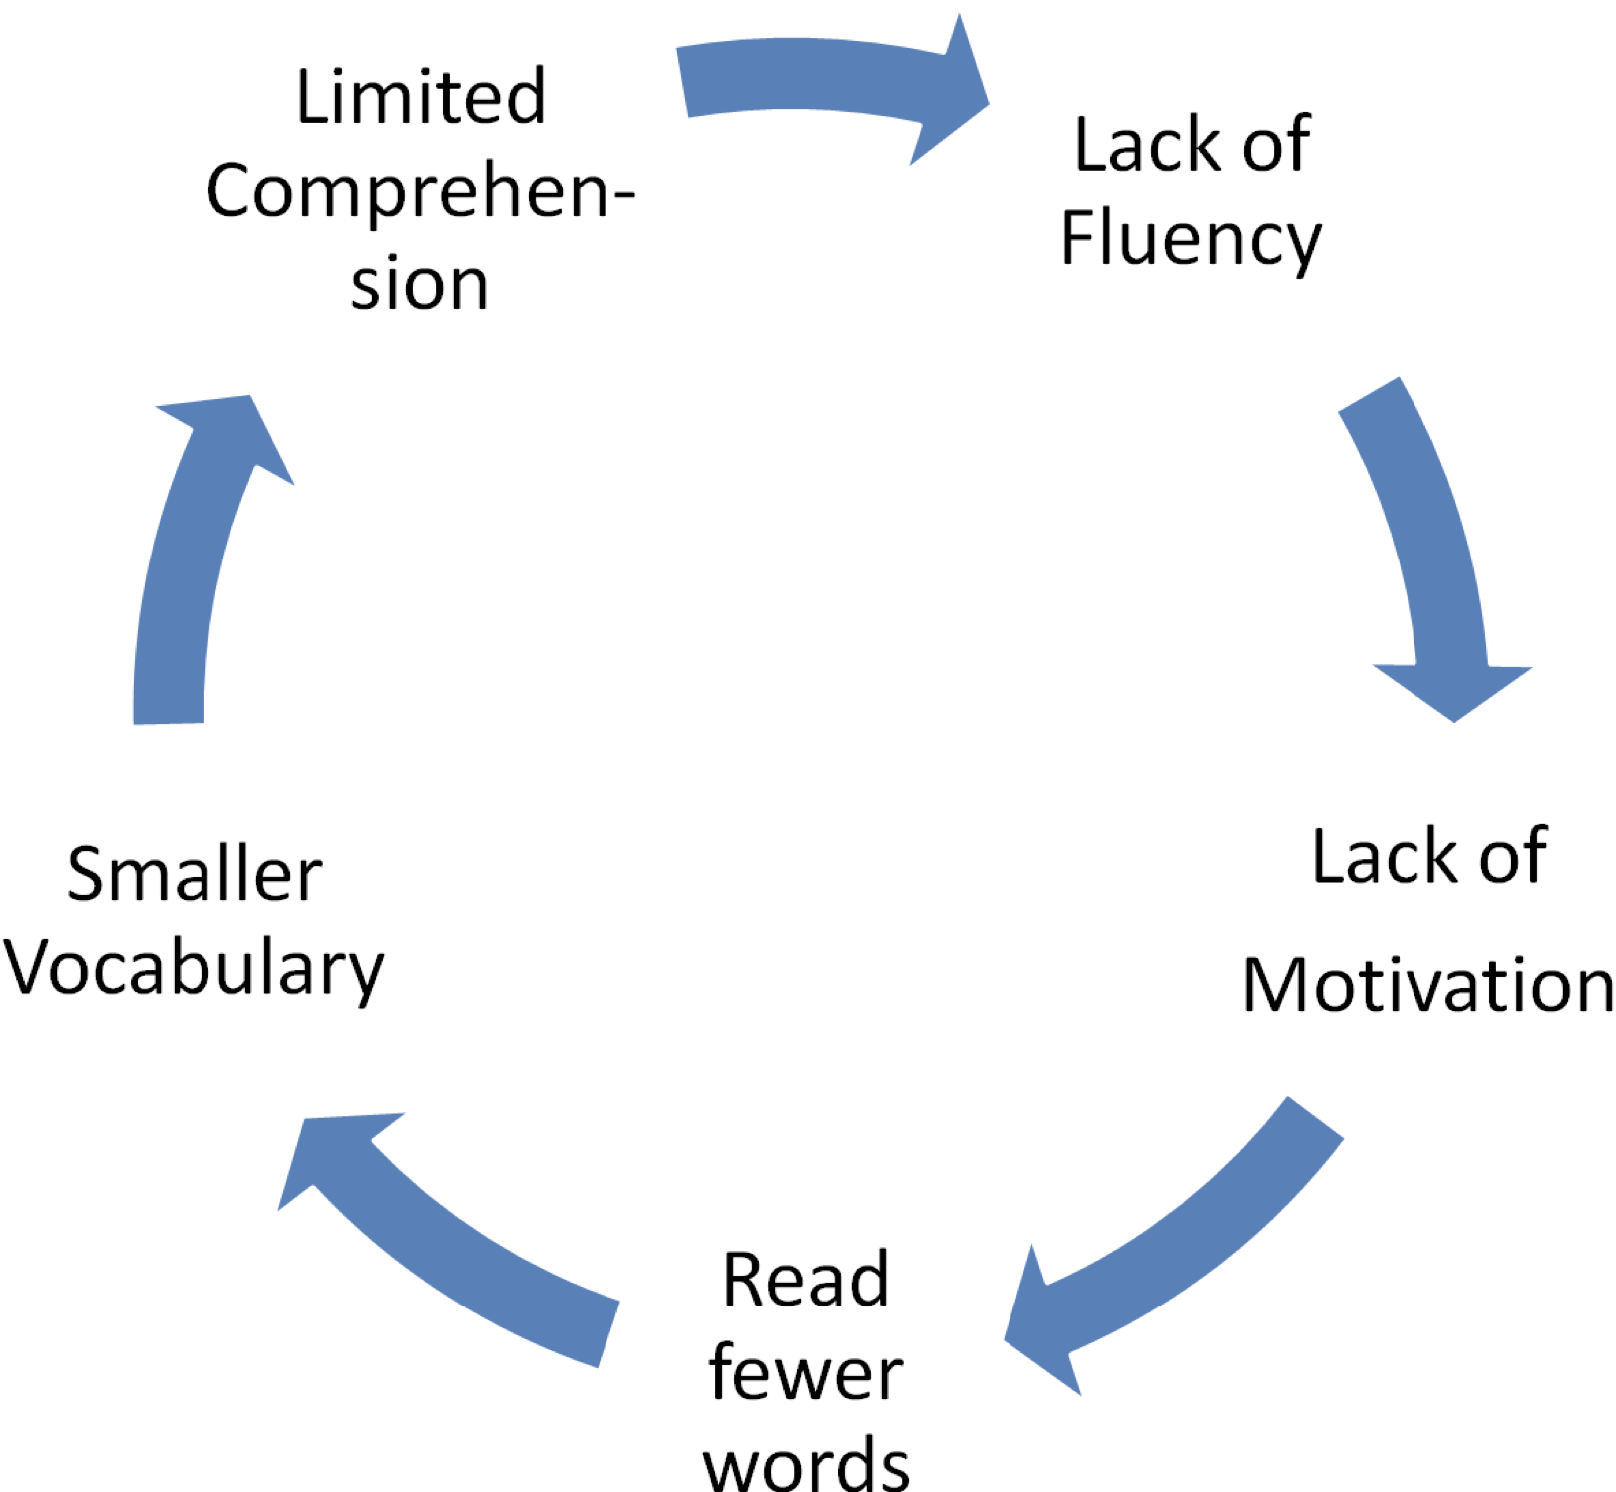
Dyslexia and other Reading Disabilities
Notes:
Corey- vicious cycle when kids struggle

Slide 8
Appropriate and Accessible Content
Wordless
Predictable
Decodable (Phonics)
Controlled Decodable
High Frequency
Hi-lo
Graphic Novels
Audiobooks
Notes:
Corey - Decodable vs leveled books -

Slide 9
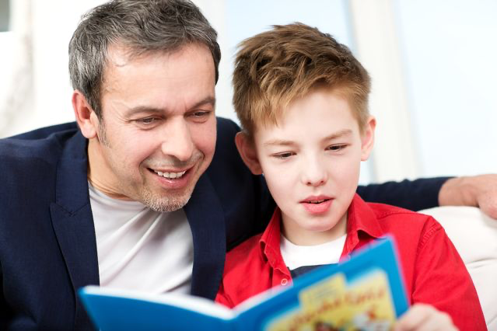
Read to them & read with them
Notes:
Corey - read to them to model fluency, allow listening comp, read with them, recognizing when materials is too hard, let them decode when possible, listen for errors

Slide 10
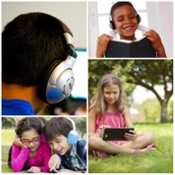
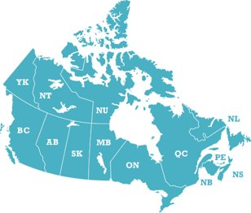
CELA
The Centre for Equitable Library Access, CELA, is Canada’s most comprehensive accessible reading service, providing books and other materials to Canadians with print disabilities in the formats of their choice.
Notes:
What is CELA? (Rachel)
Print disabilities: learning, visual and physical disabilities (can’t hold or manipulate books)
Free library of audio, e-text and braille books accessed with a public library card
CELA and Bookshare titles

Slide 11
What does CELA offer your child?
Choice
800,000 titles for kids, teens and adults
bilingual books and magazines and newspapers
Titles in different formats
DAISY audio and e-text books
Support for reading apps, other reading technology
Tutorials, videos and in-person help
Contact Centre Monday to Friday, 8:00 am to 7:30 pm Eastern time
Notes:
(Rachel)
-bilingual, but more languages through Bookshare
-no school textbooks, inquire through provincial resource centre

Slide 12
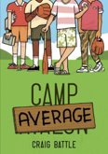
Beyond “baby books”
popular chapter books, series
magazines
Notes:
(Rachel) - variety of titles for kids of all ages, books often used in school, e.g. Wonder, Charlotte’s Web, Harry Potter, some Captain Underpants. Also books for learning such as National Geographic texts, e.g. Weird but True
Partnerships and support kids’ reading programs, Forest of Reading, Hackmatack, TD Summer Reading Club
Dear Sweet Pea - middle school (divorce)
Camp Average - summer camp, competition
Rainbow Magic - for fairy lovers, lots of titles in this series
Muse (April 2020) cover - mostly educational magazines (not Owl or Chickadee)

Slide 13
How to sign up?
•Public library card is required
•Go to https://celalibrary.ca/register or ask for assistance from public library. Public library staff can do the sign-up too.
•Proof of disability is optional and provides access to Bookshare collection
Notes:
(Rachel)

Slide 14
Educator Access and Client Access Support Programs
Educator Access
Teachers, Teachers Assistants/Aides
School Librarians
Learning Assistants
Learning Resource Teacher
Client Access Support
Occupational Therapists
Speech/Language Pathologists
Private Education Therapists
Notes:
(Rachel)
Parents can be designates on child’s CELA account
Assisting students and clients to access CELA materials, teaching independent use, connecting to the public library
Both types need public library cards to register

Slide 15
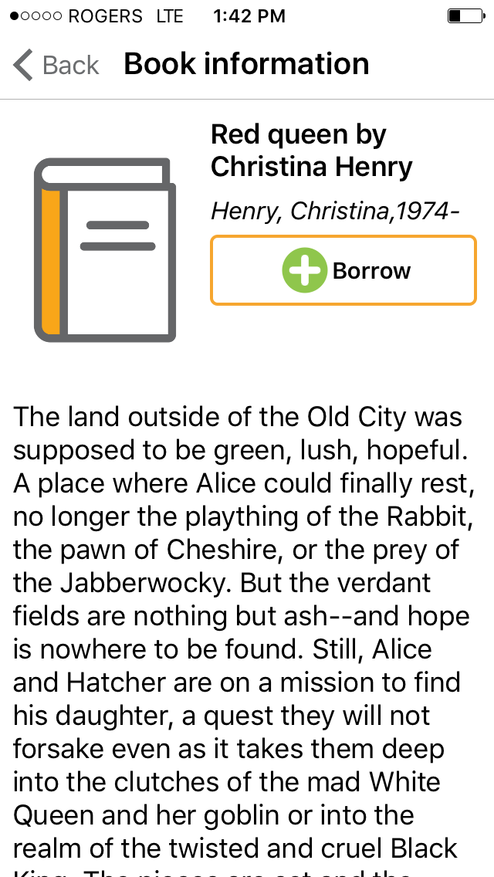
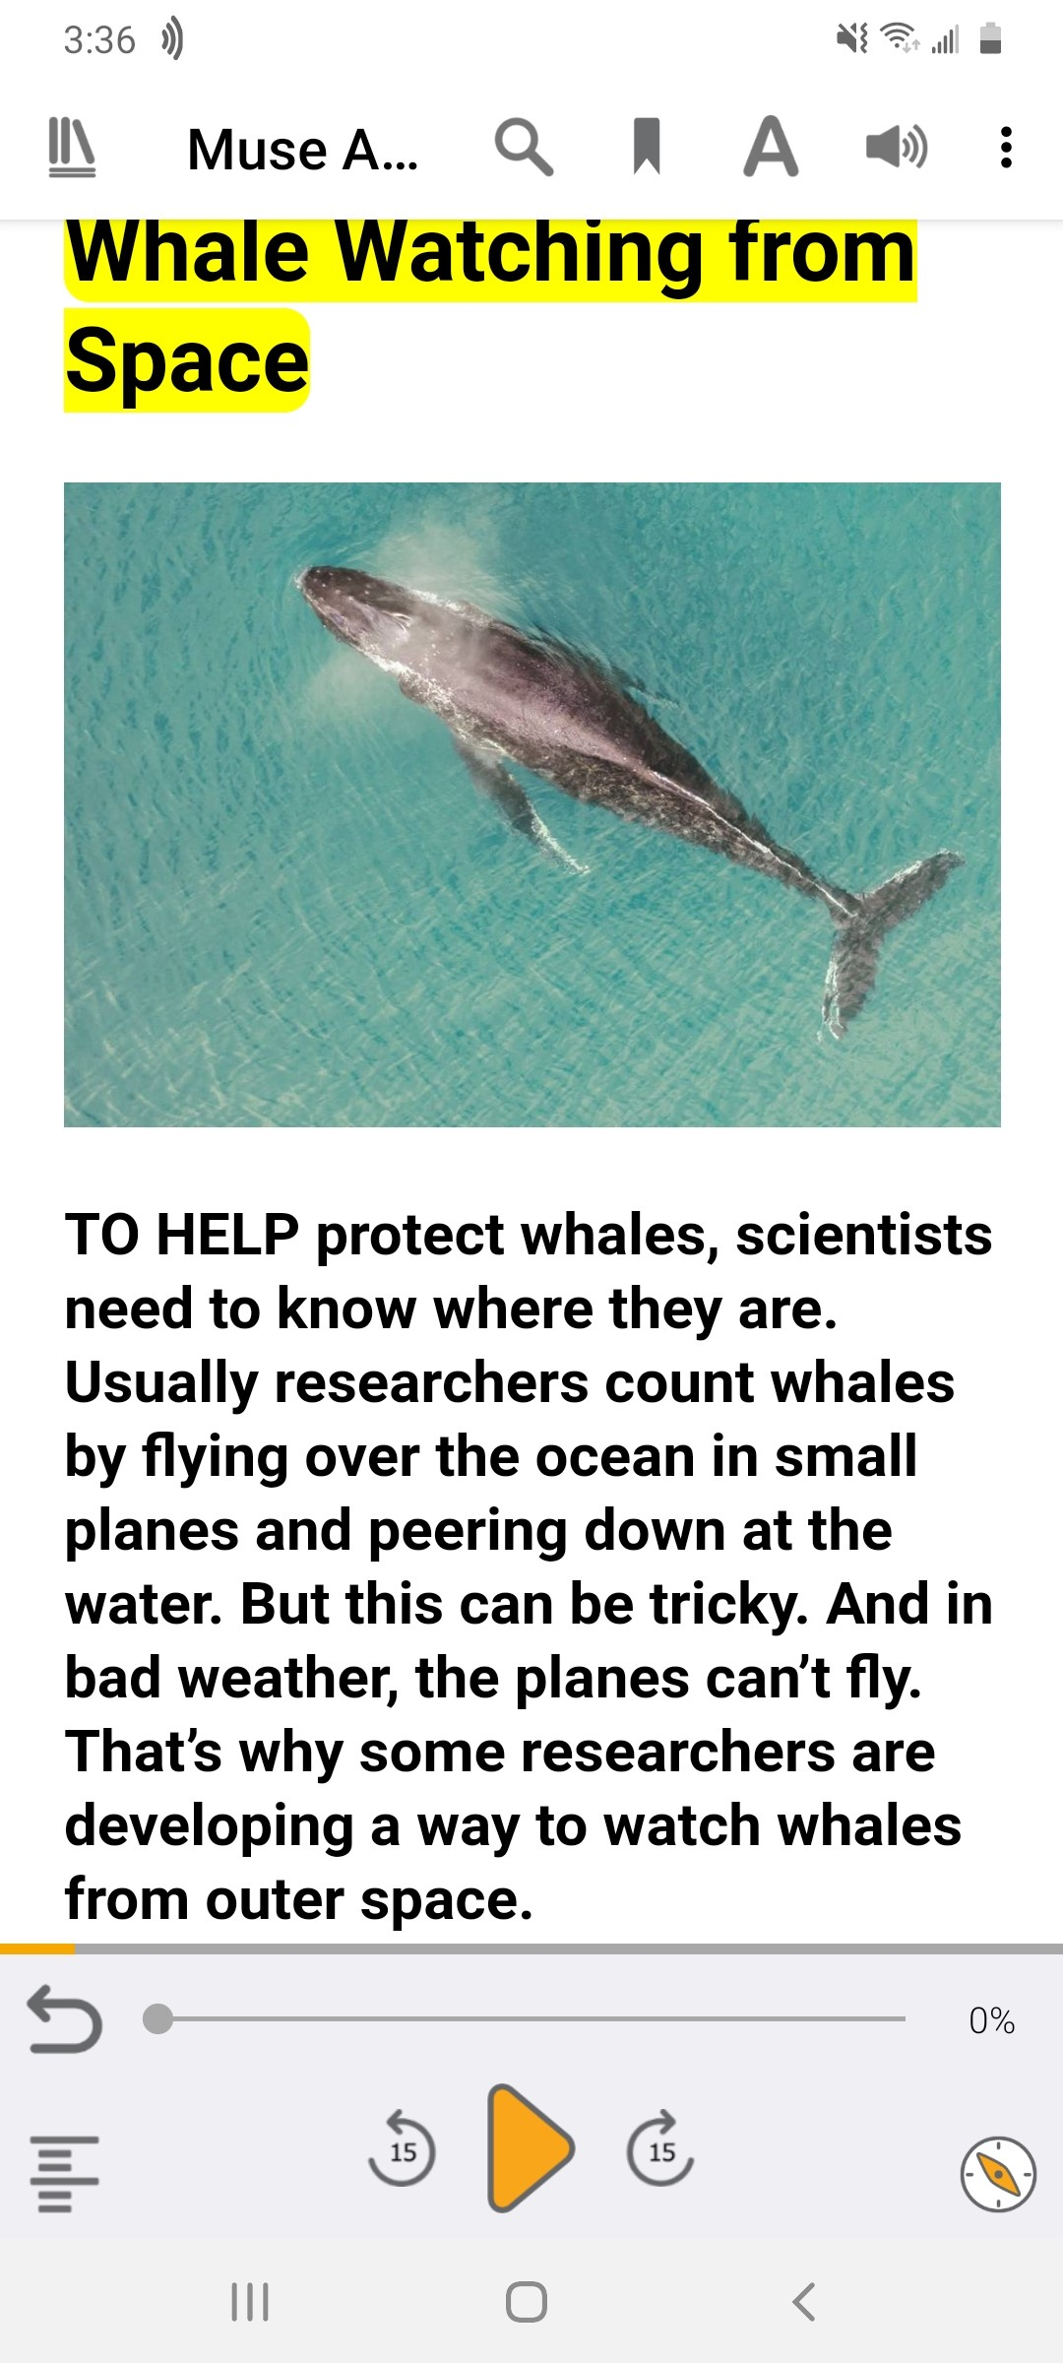
How to read books from CELA?
Tablet or phone
EasyReader
Voice Dream Reader
synchronous audio and e-text reader
i0S and Android
EasyReader (free) Voice Dream Reader ($ US)
Notes:
(Rachel) EasyReader app, Voice Dream app works as well but costs $20.99 US.
-load books directly onto the app through our Direct to Player Service
-audio only or e-text (with synth audio)
-transfer files to mp3 player using zip file
Image: EasyReader app - Screenshot of page from Muse magazine April 2020

Slide 16
How to read books from CELA?
Computer or laptop
Word, Epub, DAISY text or audio
Google Read & Write, iBooks
Word, Immersive Reader
Notes:
-choose EPub, Word, format and select the reading tool of your choice; Notepad and XML will give only a text file and font may not be friendly
-Word: enlarge text, change font
-Immersive reader for text, reads text aloud, can change between male and female synthetic voice, change page colour, breaks apart syllabels, change line spacing
-Word and graphic novels - will show images, but Immersive Reader will not read speech bubbles because they’re an image, formatting not perfect as there are empty pages.

Slide 17
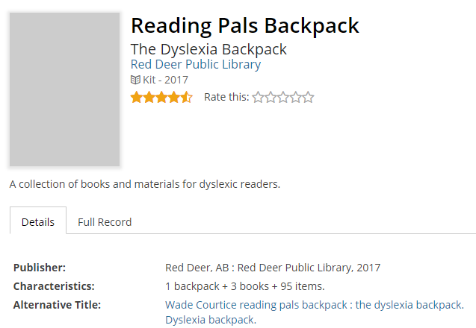
Building an accessible, appropriate and fun library (at home and school)
Accessible books at your library
Many public libraries offer:
e-book and e-audiobook collections (e.g. Overdrive, RBDigital)
decodable readers
books in dyslexic font
assistive technology (Kurzweil, loan ipads, etc.)
Notes:
Red Deer PL Backpack -3 Books. Spread your wings : a collection of Princess and Dragon stories, My friend has dyslexia / by Amanda Doering Tourville, Hank Zipzer : the world's greatest underachiever / by Henry Winkler and Li. Activity sheets, e.g. short vowel sound cards, “symptoms of dyslexia info sheet”

Slide 18
Building an accessible, appropriate and fun library (at home and school)
Handout: Publishers of Decodable Books
Book recommendations through CELA: Kids and Teens page, New Titles, Kids and Teen Book Awards page
Finding great books for kids: Canadian Children’s Book Centre, Forest of Reading, provincial reading program/summer reading club lists, GoodMinds.com (Indigenous), @FoldKids (diversity)
Notes:
(Corey & Rachel)

Slide 19
Questions?

